Slide 1
Stock Market time series analysis
Ramesh babu

Slide 2
Fetch the data from yahoo financials – MSFT ticker
date | open | high | low | close | adj_close | volume | month
0 | 2020-01-02 | 158.779999 | 160.729996 | 158.330002 | 160.619995 | 158.571075 | 22622100 | 1
1 | 2020-01-03 | 158.320007 | 159.949997 | 158.059998 | 158.619995 | 156.596588 | 21116200 | 1
2 | 2020-01-06 | 157.080002 | 159.100006 | 156.509995 | 159.029999 | 157.001373 | 20813700 | 1
3 | 2020-01-07 | 159.320007 | 159.669998 | 157.320007 | 157.580002 | 155.569855 | 21634100 | 1
4 | 2020-01-08 | 158.929993 | 160.800003 | 157.949997 | 160.089996 | 158.047836 | 27746500 | 1
5 | 2020-01-09 | 161.839996 | 162.220001 | 161.029999 | 162.089996 | 160.022308 | 21385000 | 1
6 | 2020-01-10 | 162.820007 | 163.220001 | 161.179993 | 161.339996 | 159.281876 | 20725900 | 1
7 | 2020-01-13 | 161.759995 | 163.309998 | 161.259995 | 163.279999 | 161.197144 | 21626500 | 1
8 | 2020-01-14 | 163.389999 | 163.600006 | 161.720001 | 162.130005 | 160.061798 | 23477400 | 1
9 | 2020-01-15 | 162.619995 | 163.940002 | 162.570007 | 163.179993 | 161.098419 | 21417900 | 1

Slide 3

Complete information about stock –ticker(MSFT) stored in single excel file
# show financials and all other information
financials
quarterly_financials
splits
dividends
sustainability
options
Isin
major_holders
institutional_holders
balance_sheet
quarterly_balance_sheet
cashflow
quarterly_cashflow
earnings
quarterly_earnings
sustainability
recommendations
calendar
actions
options
info

Slide 4
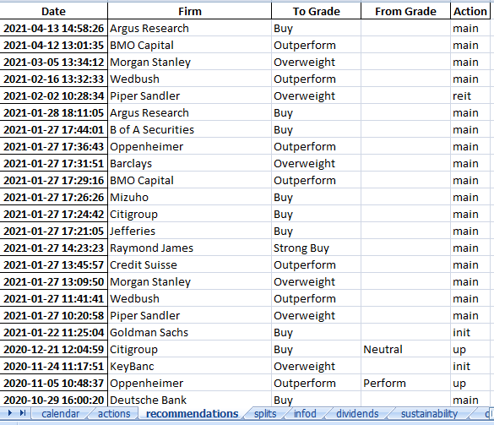

Ticker Sample info - recommendations

Slide 5
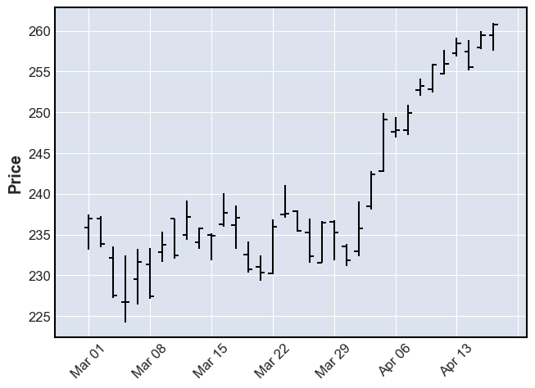
Visualizing the Stock Data

Slide 6
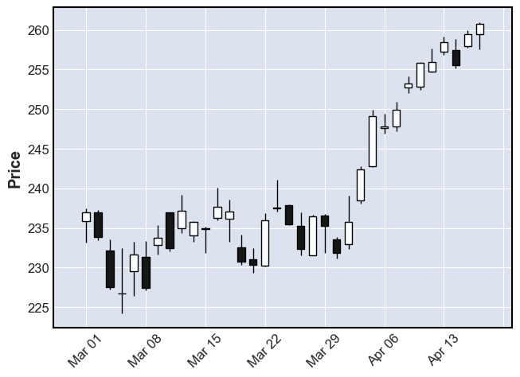

Slide 7
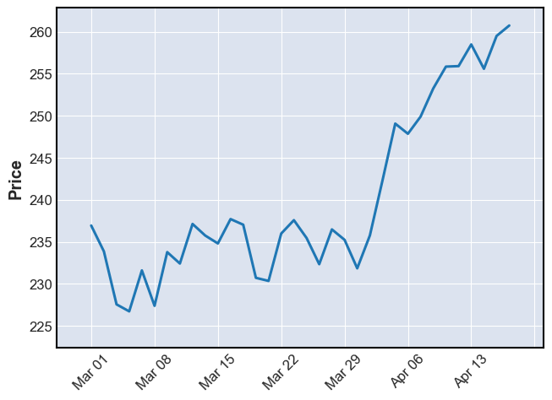

Slide 8
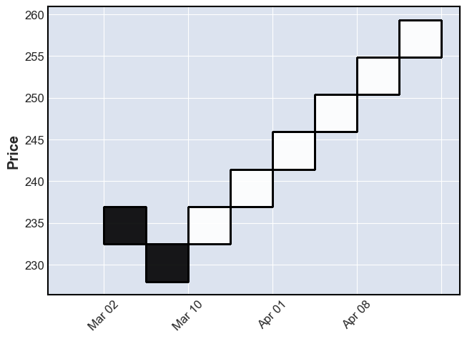

Slide 9
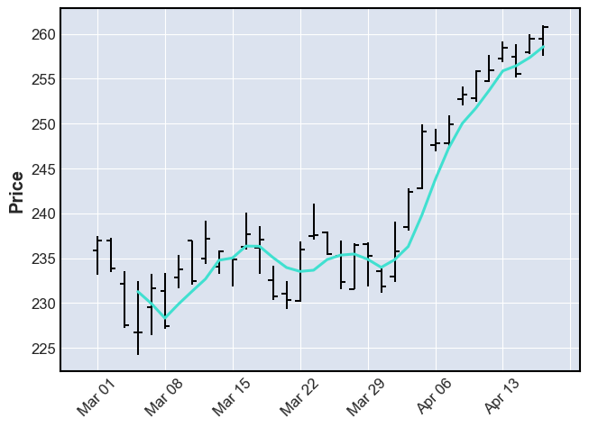

Slide 10
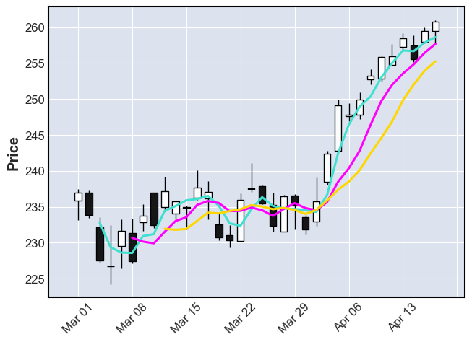

Slide 11
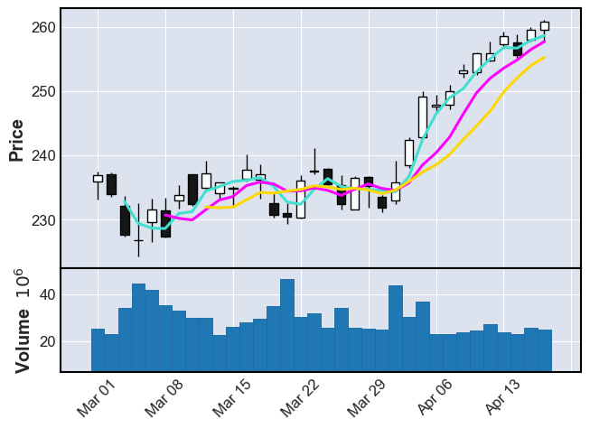

Slide 12
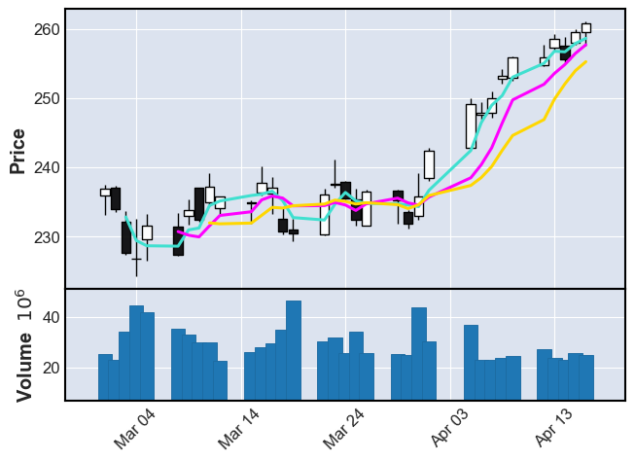
show_nontrading

Slide 13
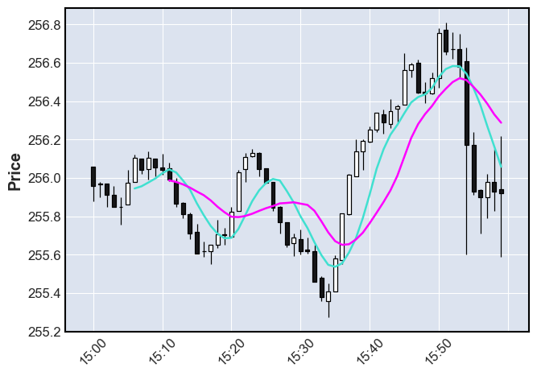
Intraday ('2021-04-12 15:00':'2021-04-12 16:00‘) last hour of trading on April 12th, with a 7 minute and 12 minute moving average.

Slide 14
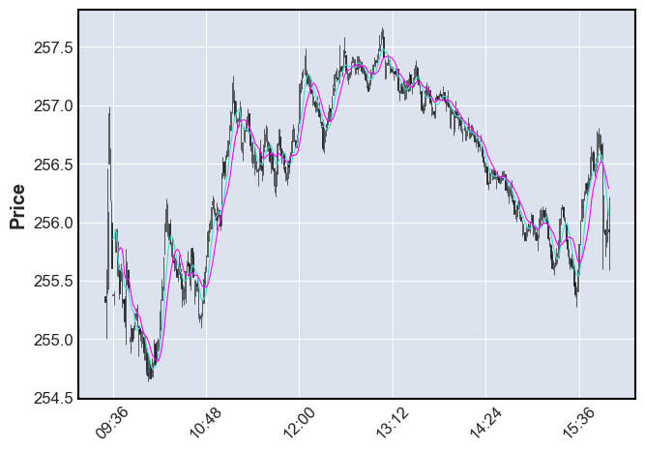

Slide 15
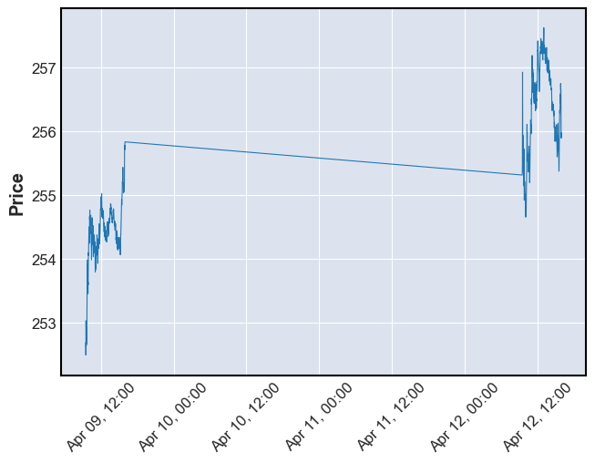

Slide 16
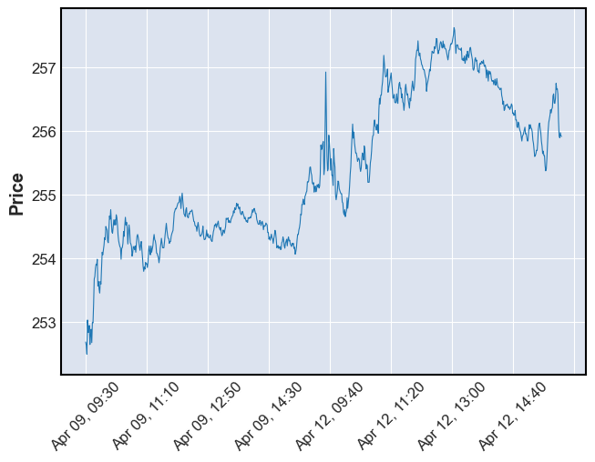

Slide 17
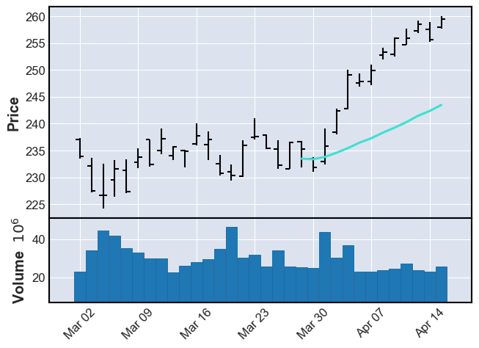

Slide 18
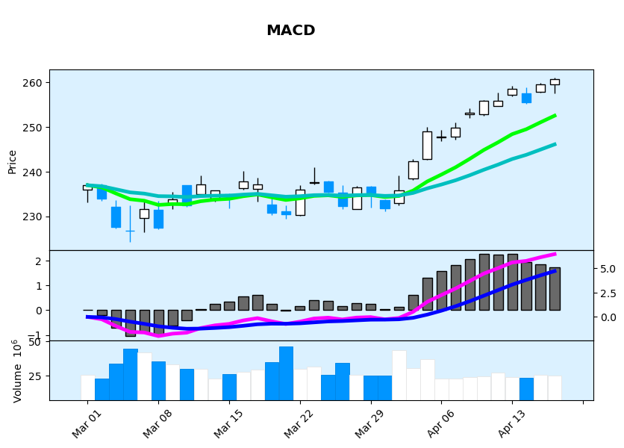

Slide 19
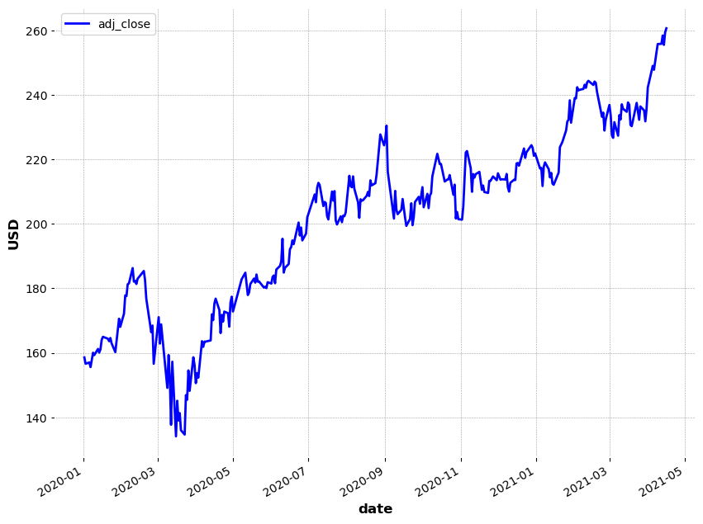
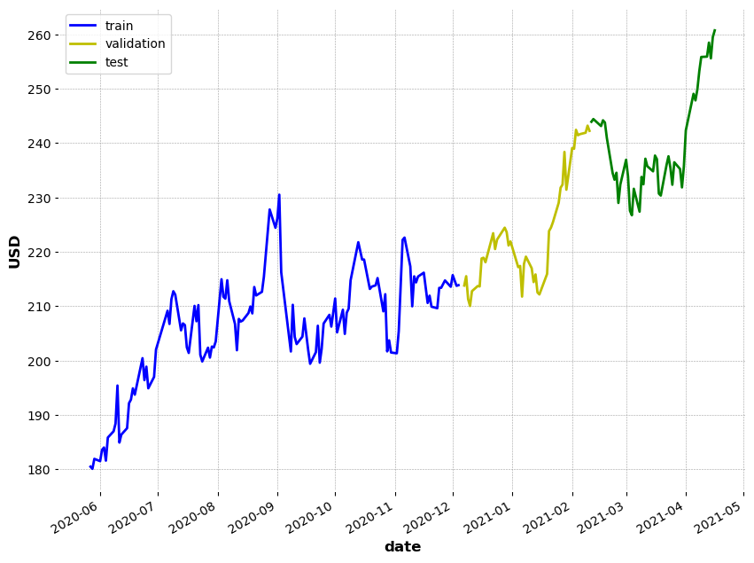
Stock Prediction using moving average

Slide 20
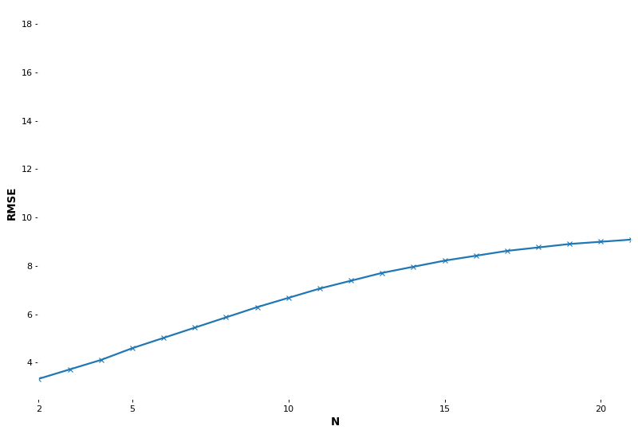
RMSE

Slide 21
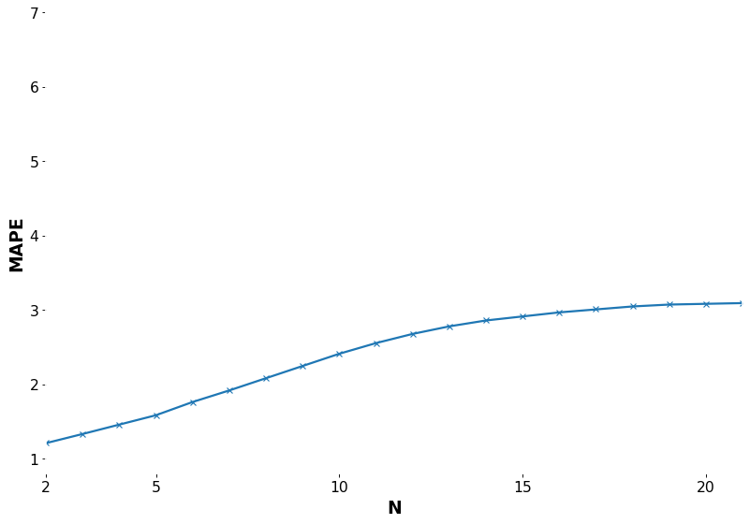
MAPE

Slide 22
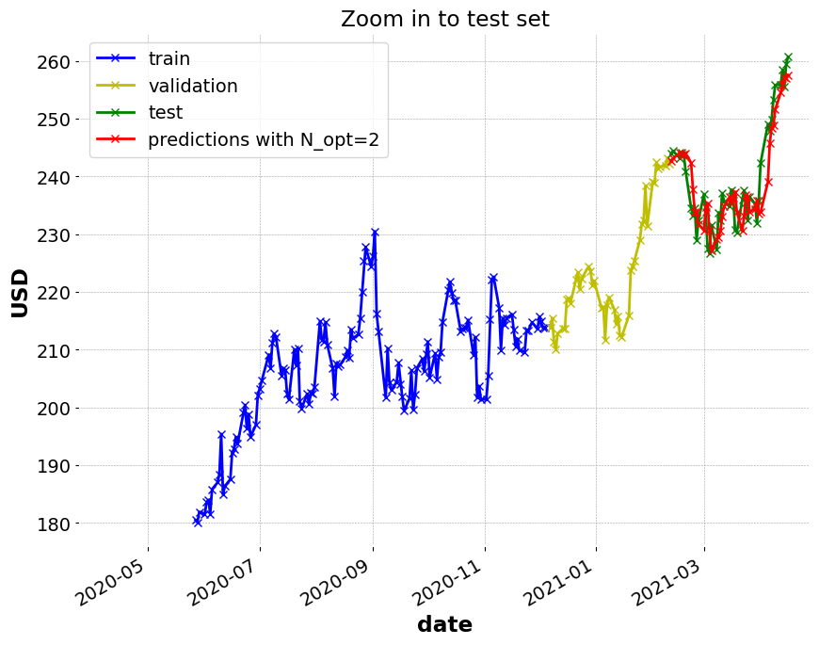

Slide 23
Conclusions
Findings
* On the dev set, the lowest RMSE is 3.24 which is achieved using N=1, ie. using value on day t-1 to predict value on day t
* On the dev set, the next lowest RMSE is 3.33 which is achieved using N=2, ie. using values from days t-2 to t-1 to predict value on day t
* We will use N_opt=2 in this work since our aim here is to use moving average
* On the test set, the RMSE is 3.964 and MAPE is 1.341% using N_opt=2

